Slide 1
Results of the 2018 NSSP CoP Member Satisfaction Assessment
NSSP CoP Update
2018 ISDS Conference

Slide 2
Financial support for the project was provided by the Centers for Disease Control and Prevention (CDC) through the National Syndromic Surveillance Program Community of Practice (NSSP CoP): Strengthening Health Surveillance Capabilities Nationwide Cooperative Agreement (#1NU50OE000098-01). The contents of this report are solely the responsibility of the authors and do not necessarily represent the official views of CDC.
Data was collected under the Office of Management and Budget (OMB) Paperwork Reduction Act (PRA) Generic Information Collection. OMB Control No. 0920-0879: Information Collections to Advance State, Tribal, Local and Territorial (STLT) Governmental Agency System Performance, Capacity, and Program Delivery.

Slide 3
Survey Administration
Method and Instrument
Online survey, administered via Survey Monkey ®
Anonymous, voluntary, and took approximately 15 minutes to complete
23 total questions across multiple domains:
engagement in NSSP CoP activities
awareness and use of NSSP CoP tools and resources
utility and ease of navigation of the ISDS website
use of collaborations and partnerships
value and satisfaction with membership in the NSSP CoP
respondent characteristics
Participation
197 NSSP CoP members invited from state, local, and federal agencies
Two weeks (May 7 to May 21, 2018) to complete the assessment

Slide 4
Respondent Demographics
52/197 individuals completed the survey (26%)
Table 1. Response Rate by Public Health Agency (n=43)
 | State | Local | Federal
Number of NSSP members* | 103 | 50 | 44
Response rate, n (%) | 33 (32) | 8 (16) | 2 (4.5)
* Based on the total NSSP CoP membership as of February 23, 2018 with a state, local or federal email address.
More than 60% of respondents reported having worked in syndromic surveillance between 2-5 years.
16% reported less than 1 year of experience in syndromic surveillance.

Slide 5
Respondent Demographics (cont.)
More than 58% of respondents reported their primary role in relation to syndromic surveillance practice is as an Epidemiologist and more than 37% reported being Data Analysts (Figure 1).

Slide 6
Engagement in NSSP CoP Activities
More than 40 respondents (80%) stated that they regularly attend (at least once every quarter) the monthly NSSP Community of Practice call.
92.8% reported that they either agree or strongly agree that the call is a good use of their time.
95.2% reported that they either agree or strongly agree that the call provides important and relevant information.

Slide 7
Engagement in NSSP CoP Activities
Table 2: Characteristics of the NSSP CoP Call (n=42)
 | Survey Responses, n (%)
 | Strongly Disagree | Disagree | Neutral | Agree | Strongly Agree
Is a good use of my time. | 2 (4.8) | 0 (0.0) | 1 (2.4) | 30 (71.4) | 9 (21.4)
Is well organized/facilitated. | 1 (2.4) | 0 (0.0) | 0 (0.0) | 30 (71.4) | 11 (26.2)
Provides a welcoming environment where I feel comfortable providing my opinion. | 1 (2.4) | 0 (0.0) | 6 (14.3) | 22 (52.4) | 13 (30.9)
Provides important and relevant information. | 2 (4.8) | 0 (0.0) | 0 (0.0) | 30 (71.4) | 10 (23.8)
Showcases syndromic surveillance best practices. | 2 (4.8) | 1 (2.4) | 3 (7.1) | 26 (61.9) | 10 (23.8)
Generates new ideas for syndromic surveillance practice. | 2 (4.8) | 0 (0.0) | 8 (19.1) | 23 (54.8) | 9 (21.4)

Slide 8
Awareness, Availability, and Use of Tools for the NSSP CoP
The most utilized tool on the ISDS website (www.healthsurveillance.org) is the Group or Community Calendar
More than 57.1% of respondents reported using at least once a month
The second most popular tool is the Group or Community Forums
49.0% reported using the forums at least once a month

Slide 9
Awareness, Availability, and Use of Tools for the NSSP CoP (cont.)
Table 3: Frequency of use of Group Virtual Spaces/Tools (n=49)
 | Survey Responses, n (%)
 | Daily to Once a Week | Several Times a Month | About Once a Month | I Don’t Use This Tool
I utilize the Group or Community Calendar to identify the dates and times of group calls. | 6 (12.2) | 7 (14.3) | 15 (30.6) | 21 (42.9)
I utilize the Group or Community Forums to post questions to the community/group. | 4 (8.2) | 4 (8.2) | 16 (32.6) | 25 (51.0)
I utilize "My Feed" or the "Group Feed" to share updates with the community/group. | 2 (4.0) | 4 (8.2) | 7 (14.3) | 36 (73.5)
I utilize the Message feature to send emails to the community/group. | 2 (4.0) | 4 (8.2) | 10 (20.4) | 33 (67.4)
I utilize the Connection feature to connect with other members of the community. | 2 (4.0) | 3 (6.1) | 16 (32.7) | 28 (57.2)

Slide 10
Awareness, Availability, and Use of Tools for the NSSP CoP (cont.)
The majority of respondents (46%) reported using the Surveillance Knowledge Repository about once a month.
Of the individual “Libraries,” the Syndrome Definition Library was reported to be used the most frequently, with 10.9% of respondents reporting that they used it daily to weekly and an additional 17.3% reporting using it several times a month.

Slide 11
Awareness, Availability, and Use of Tools for the NSSP CoP (cont.)
Table 4: Frequency of use of Resource Sharing Tools (n=46)
 | Survey Responses, n (%)
 | Daily to Once a Week | Several Times a Month | About Once a Month | I Don’t Use This Tool
I utilize the Surveillance Knowledge Repository. | 8 (17.4) | 9 (19.6) | 21 (45.6) | 8 (17.4)
I utilize the Webinar Library. | 4 (8.7) | 7 (15.2) | 23 (50.0) | 12 (26.1)
I utilize the GitHub Code Sharing Library. | 0 (0.0) | 3 (6.5) | 11 (23.9) | 32 (69.6)
I utilize the Syndrome Definitions Library. | 5 (10.9) | 8 (17.4) | 15 (32.6) | 18 (39.1)
I utilize the Stories of Surveillance in Action Library. | 3 (6.5) | 6 (13.1) | 14 (30.4) | 23 (50.0)

Slide 12
Likelihood of Recommending NSSP CoP Resources
63% of respondents stated that they were very likely to share information about the KR, the Webinar Library, the Syndrome Definitions Library, and the monthly NSSP CoP calls
Table 5: Likelihood of Recommending NSSP CoP Resources (n=46)
 | Survey Responses, n (%)
 | Not Very Likely | Somewhat Likely | Very Likely | No basis to judge
Surveillance Knowledge Repository. | 1 (2.1) | 8 (17.4) | 32 (69.6) | 5 (10.9)
Webinar Library. | 1 (2.1) | 10 (21.7) | 29 (63.1) | 6 (13.1)
GitHub Code Sharing Library. | 1 (2.1) | 3 (6.5) | 21 (45.7) | 21 (45.7)
Syndrome Definitions Library. | 1 (2.1) | 4 (8.7) | 32 (69.6) | 9 (19.6)
Stories of Surveillance in Action Library. | 2 (4.4) | 6 (13.0) | 26 (56.5) | 12 (26.1)
The monthly NSSP Community of Practice Call. | 2 (4.4) | 14 (30.4) | 28 (60.9) | 2 (4.3)

Slide 13
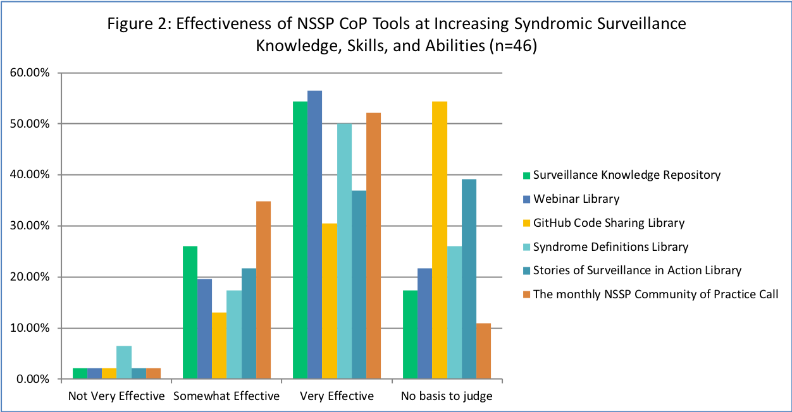
Increase in Syndromic Surveillance Knowledge
A majority of respondents found that the general KR, the Webinar Library (56.5%), and the monthly NSSP CoP calls (52.2%) were very effective at increasing their syndromic surveillance knowledge.

Slide 14
Navigation of the ISDS Website
More than 60% of respondents reported that they use the ISDS website as their primary source of information about syndromic surveillance.
Table 6: Agreement regarding Navigation of the ISDS Website (n=44)
 | Survey Responses, n (%)
 | Strongly Disagree | Disagree | Neutral | Agree | Strongly Agree
Overall the website is easy to use. | 0 (0.0) | 7 (15.9) | 11 (25.0) | 23 (52.3) | 3 (6.8)
Information on the website is easy to find. | 1 (2.3) | 8 (18.2) | 12 (27.3) | 20 (45.4) | 3 (6.8)
I use the website as my primary source for information about syndromic surveillance. | 0 (0.0) | 2 (4.5) | 14 (31.8) | 19 (43.2) | 9 (20.5)

Slide 15
Assessment of Collaborations and Partnerships
More than 70% agreed or strongly agreed that membership has helped to facilitate collaborative activities outside of their organization.
More than 70% of respondents reported that being a member of the NSSP CoP has motivated them to pursue partnerships with others in the SyS community.

Slide 16
Assessment of Collaborations and Partnerships (cont.)
Respondents were asked to suggest ways to help further facilitate collaborations among NSSP CoP members:
reducing the barriers to participating in collaborative projects (i.e. not having to register for individual calls in a call series, provide more options for notifications regarding new NSSP CoP-related events);
requesting feedback from members on what is needed to advance SyS practice in their jurisdictions; and
providing more opportunities for members to collaborate on specific tasks during in-person meetings.

Slide 17
Assessment of Collaborations and Partnerships (cont.)
Table 7: Degree to which Membership in the NSSP CoP has Benefited Respondents (n=44)
 | Survey Responses, n (%)
 | Strongly Disagree | Disagree | Neutral | Agree | Strongly Agree
Being a member of the NSSP Community of Practice has helped me facilitate collaborative syndromic surveillance partnerships/activities with others within my organization or jurisdiction. | 3 (6.8) | 6 (13.6) | 12 (27.3) | 16 (36.4) | 7 (15.9)
Being a member of the NSSP Community of Practice has helped me facilitate collaborative syndromic surveillance partnerships/activities with others outside my organization or jurisdiction. | 2 (4.5) | 2 (4.5) | 9 (20.5) | 16 (36.4) | 15 (34.1)
Being a member of the NSSP Community of Practice has motivated me to partner with others in the syndromic surveillance community to resolve common problems or issues. | 2 (4.5) | 1 (2.3) | 10 (22.7) | 15 (34.1) | 16 (36.4)
Being a member of the NSSP Community of Practice reduces duplication of efforts and prevents “reinvention of the wheel.” | 1 (2.3) | 3 (6.8) | 11 (25.0) | 18 (40.9) | 11 (25.0)

Slide 18
Value and Satisfaction with membership in the NSSP CoP
More than 60% of respondents reported being very satisfied with their membership in the NSSP CoP with an additional 34% reporting being somewhat satisfied.
More than 88% of respondents agreed or strongly agreed that the NSSP CoP has improved their knowledge, skills, and abilities related to conducting SyS and almost 91% agreed or strongly agreed that it helps them to stay current in the field.

Slide 19
Value and Satisfaction with membership in the NSSP CoP (cont.)
Almost 80% agreed or strongly agreed that membership in the NSSP CoP helped them to build professional relationships and network with others in the SyS community.
Approximately, 75% of respondents agreed or strongly agreed that membership in the NSSP CoP helps to build trust, rapport, and a sense of community.

Slide 20
Value and Satisfaction with membership in the NSSP CoP (cont.)
Table 8: Perceived Value of the NSSP CoP (n=44)
 | Survey Responses, n (%)
 | Strongly Disagree | Disagree | Neutral | Agree | Strongly Agree
Has improved my knowledge, skills, and abilities related to conducting syndromic surveillance. | 2 (4.5) | 0 (0.0) | 3 (6.8) | 28 (63.7) | 11 (25.0)
Helps me stay current in the syndromic surveillance field. | 2 (4.5) | 0 (0.0) | 2 (4.5) | 26 (59.1) | 14 (31.8)
Leverages a variety of knowledge sharing tools (knowledge repository, workgroups, forums, etc.) | 2 (4.5) | 1 (2.3) | 8 (18.2) | 20 (45.5) | 13 (29.5)
Allows me to share my work and success stories with others. | 2 (4.5) | 2 (4.5) | 12 (27.3) | 18 (40.9) | 10 (22.7)
Helps me build professional relationships and network with others in the syndromic surveillance community. | 2 (4.5) | 2 (4.5) | 5 (11.4) | 18 (40.9) | 17 (38.6)
Builds trust, rapport, and a sense of community. | 2 (4.5) | 3 (6.8) | 6 (13.6) | 17 (38.6) | 16 (36.4)
Provides me with learning opportunities (webinars, trainings) | 2 (4.5) | 0 (0.0) | 3 (6.8) | 20 (45.4) | 19 (43.2)

Slide 21
Value and Satisfaction with membership in the NSSP CoP (cont.)
“I like the community of practice because its peers sharing with peers. Everyone seems like 'equals" and there is great collaboration. Please keep it that way. We don't need an 'us against them' mentality.”
“The CoP is an excellent resource and I greatly appreciate the tools, networking, and training opportunities it provides.”

Slide 22
Recommendations
ISDS recommends continuing to focus member engagement efforts on the tools that the current NSSP CoP membership is aware of and using, specifically the Group and Community Calendars and Forums.
Increase member willingness to post questions to the community by designating regular time periods where members gather to address questions around specific topics via the forums, called Forum Fridays.

Slide 23
Recommendations (cont.)
Designate a new group member role, the Forum Champions, who would commit to reviewing forum posts on a weekly basis and reaching out to specific community members, via email, to encourage them to login to the website and respond to other members on the forums.
Targeting engagement efforts at the Committee and Workgroup levels by enlisting the assistance of the Chairs and Group Administrators of these groups. ISDS recommends providing monthly Engagement Reports to the Chairs and Administrators.

Slide 24
Recommendations (cont.)
Designate a new group member role, the New Member Ambassador, who would commit to reviewing the list of new NSSP CoP members on a monthly basis and reaching out to these new members directly, to introduce them to all of the ways they can get engaged with community activities.
ISDS will help to facilitate and support at least one Expert Panel of NSSP CoP members as a method of allowing NSSP CoP members to share their experience and knowledge with the entire CoP.

Slide 25
Limitations
Assessment results may not be representative of the entire NSSP CoP membership, as the OMB PRA approval for this data collection limited our assessment to state, tribal, local, and territorial public health staff only.
ISDS recommends repeating the assessment to include the entire NSSP CoP membership.

Slide 26
Questions?
Any questions or comments?

